Slide 1
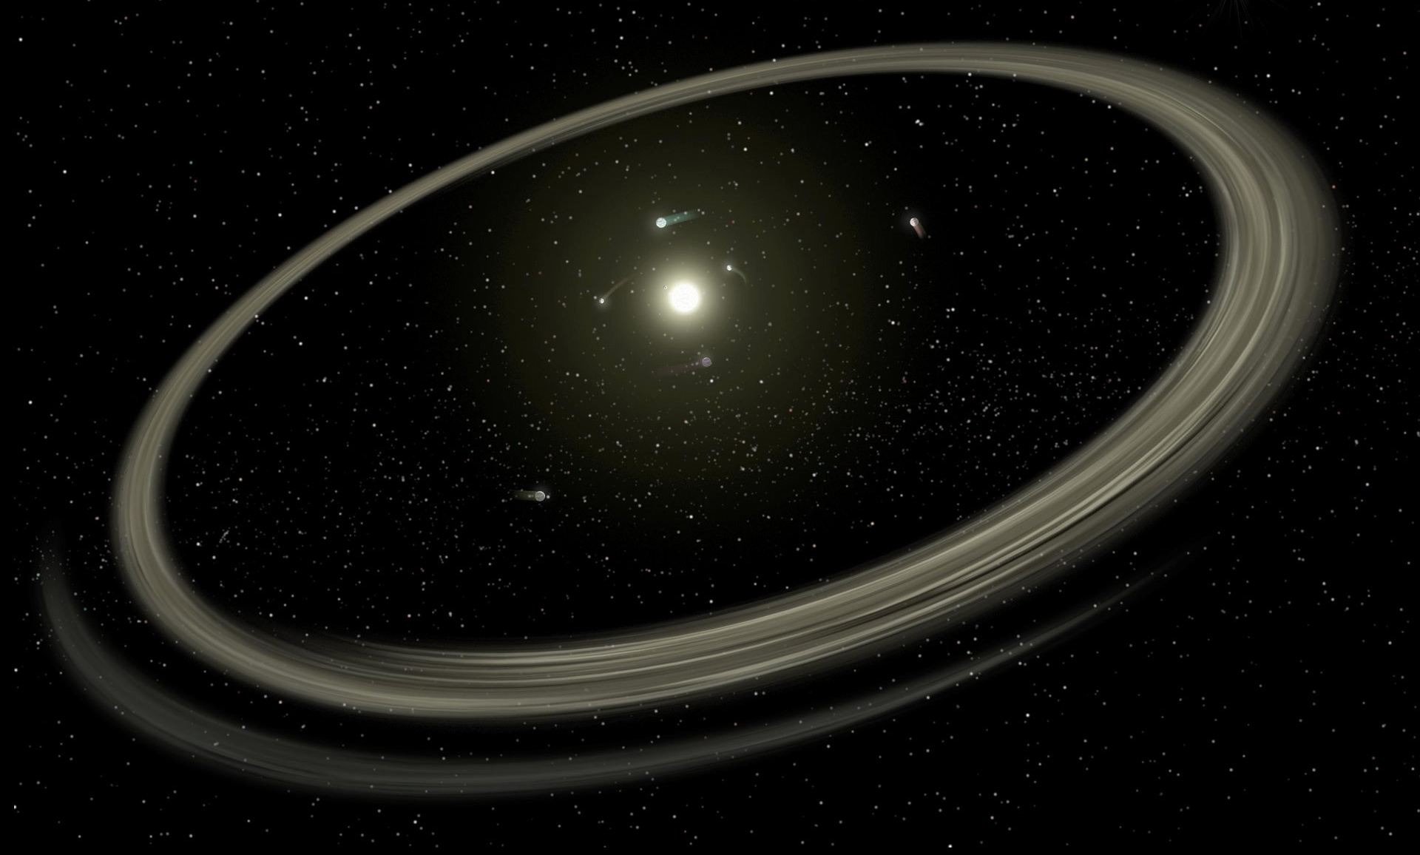
Debris Discs A key component of planetary evolution
Supervisors: Prof. Jonti Horner, Dr. Jonty Marshall, and A/Prof. Stephen Marsden
Image Source: Scitechdaily.com
Notes:
I would like to begin to acknowledge the the traditional owners of the land that we’re all meeting on today, the Gadigal People of the Eora nation, I pay my respects to their Elder’s past and present and I recognise their continuing connection and custodianship of the lands, seas, and waters throughout Australia. I would also like to acknowledge the First Nations people of Australia were the first scientists and engineers, with contribution to land management, farming, and astronomy.

Slide 2
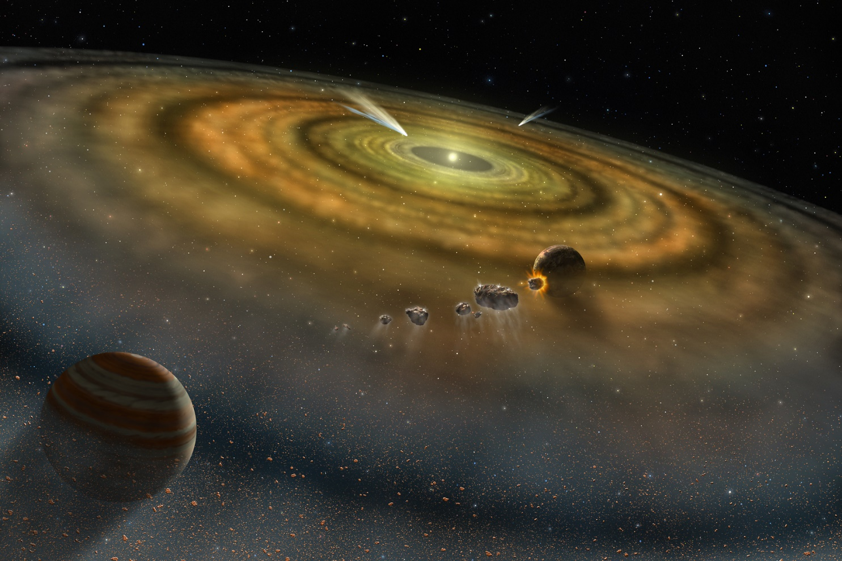
Debris Disc formation
Image Credit: Lynette Cook
Notes:
The gas in the disc is ionised by the host star (cosmic rays & x-ray emission) to then be carried away by the stellar wind (stream of charged particles).
The dispersion of the gas in the disc is thought to occur between 3 to 10 million years since the start of star formation (for Sun-like stars) and lasts for 250 000 years. The leaves behind the debris disc.

Slide 3
Notes:
Planet formation is not a sequential process |
Planetesimal formation period
Planetesimals, namely comets and asteroids in the system
The aggregation of planetesimals is dependent on slow velocity collisions
High-energy impacts yield planetesimal fragmentations reproducing dust – called collisional grinding
Debris Discs have been observed long after the formation of the planets (> 100 million years)

Slide 4
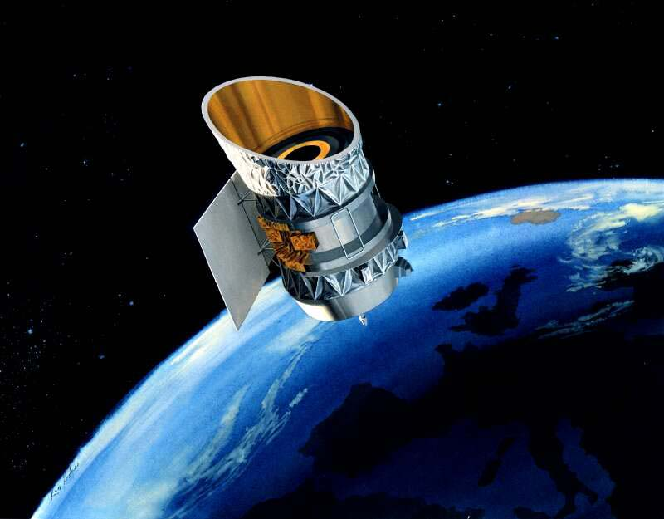
First Detections from IRAS
Neugebauer et al. (1984)
Notes:
Space Telescope
Detect level infrared radiation
Infrared Astronomical Satellite
12/25/60/100 μm
First discovered of debris discs around stars

Slide 5
Vega Black Body Example
Notes:
Black Body Curve of Vega ~9850K
Age of Vega = 455 Million Years

Slide 6
Extended Emission
Aumann et al. (1984)
Notes:
12 – 100 microns | IRAS Detections
Star detected above what was expected – “Extended emission” objects
Proposed idea of debris discs
Note: these objects are dimmer than protoplanetary discs
Vega age: 450 million years old (relatively young for a debris disc that I have studied), but where the protoplanetary disc has long gone.

Slide 7
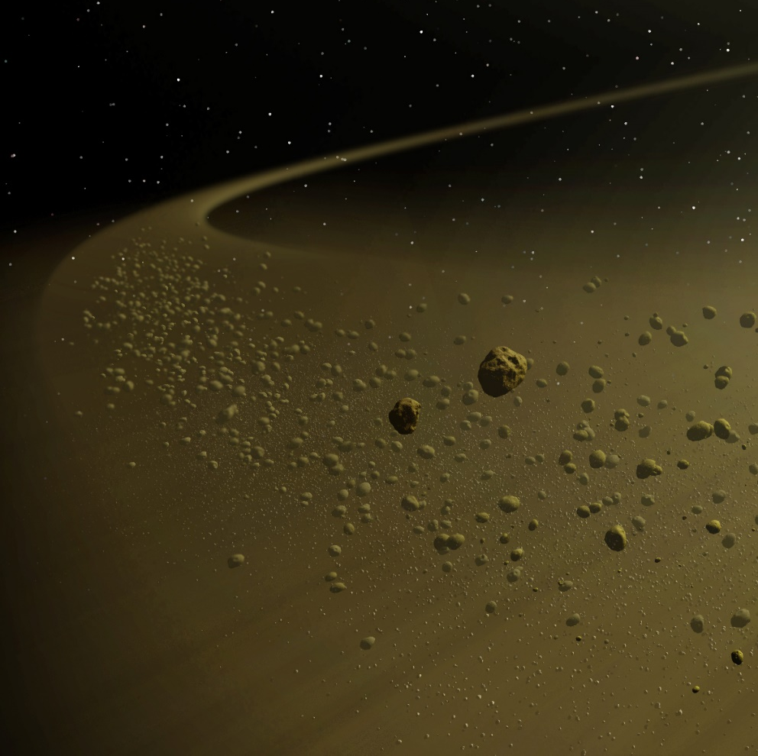
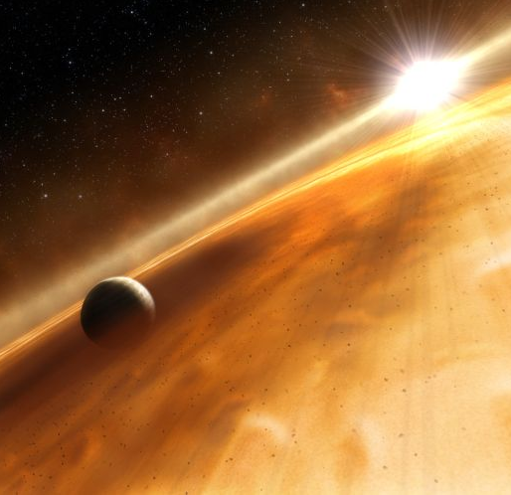
Disc Stirring
Self-stirring
Planetary
Image Credit: T. Pyle/NASA
Image Credit: ESA/ESO
Notes:
In order for debris discs to become detectable, i.e. planetesimal collision – dynamical excitation mechanism is thought to increase the velocities for planetesimals during collisions – grinding planetesimals down into fine grains.
Two mechanisms: self-stirring | gravitational perturbations between the planetesimals / planets | planets/protoplanets migrating through the disc stirring up the planetesimals.
Stirring could help explain difference types of disc structures such as gaps, warps and asymmetries of debris discs
Basic structure (next slide) using our Solar system as an example

Slide 8
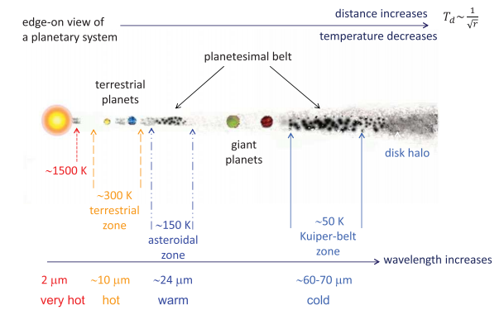
Zones of Debris Dust
Credit: Su & Rieke et. al. (2014)
Notes:
Closer to star, hotter the dust
Left to right
1500K – nanoscale hot grains; trap in the stellar magnetic field
300K / 150K – terrestrial and asteroidal warm dust zone
50K – outer/cool dust
Warmer than what they should be for their given radial distance due to the inefficiency of dust emission of Small dust grains;
blown out radiation pressure sub-mm/mm RJ part of the spectrum (outer cool dust)
Driven by our biases of the limitations of the instruments we have (namely sensitive)
Peak radiation wavelength
Radiation at longer wavelengths : larger grains
“ at shorter wavelengths: smaller grains
Su & Rieke Al. 2014
This example shows is the analogy of Solar system. This is showing a debris disc with two planetesimal belts: 1. Asteroid and 2. Edgeworth-Kuiper Belt
Due to the availability of more solid material in the outer regions of the disc (passed the ice line) , the cores of the outer planets’ can grow larger: typically between 8 and 20 Earth masses. Thus, enabling the outer planets to hold onto more gas.
This is believed why terrestrial can only hold on due to gravitation attraction of a thin layer of gas whilst the outer planets can hold onto more of their outer gaseous/fluid envelope.
The outer planets typically form faster, up to 10 million years, whilst the inner rocky planets can take up to 100 Million years

Slide 9
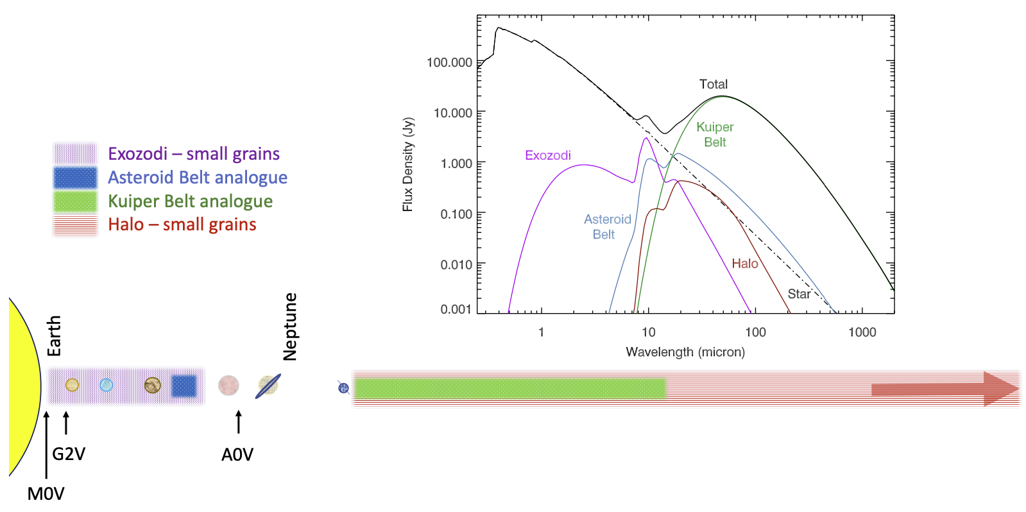
Debris Disc Architecture
Modified from Figure 1 of Hughes et al (2018)
Notes:
Debris discs are composed of planetesimals located in belts that can grind down to produce sub-micron sized grains.
The SED shows illustrative examples of different debris disc system architecture that may be observed by their peak temperature, which can be linked to their spatial location as depicted in the schematic below.
The Halo is thought to be dominated by grains that have been pushed outside the planetesimal belt by radiation pressure either on highly eccentric orbits or on paths that are completely blown out of the system.

Slide 10
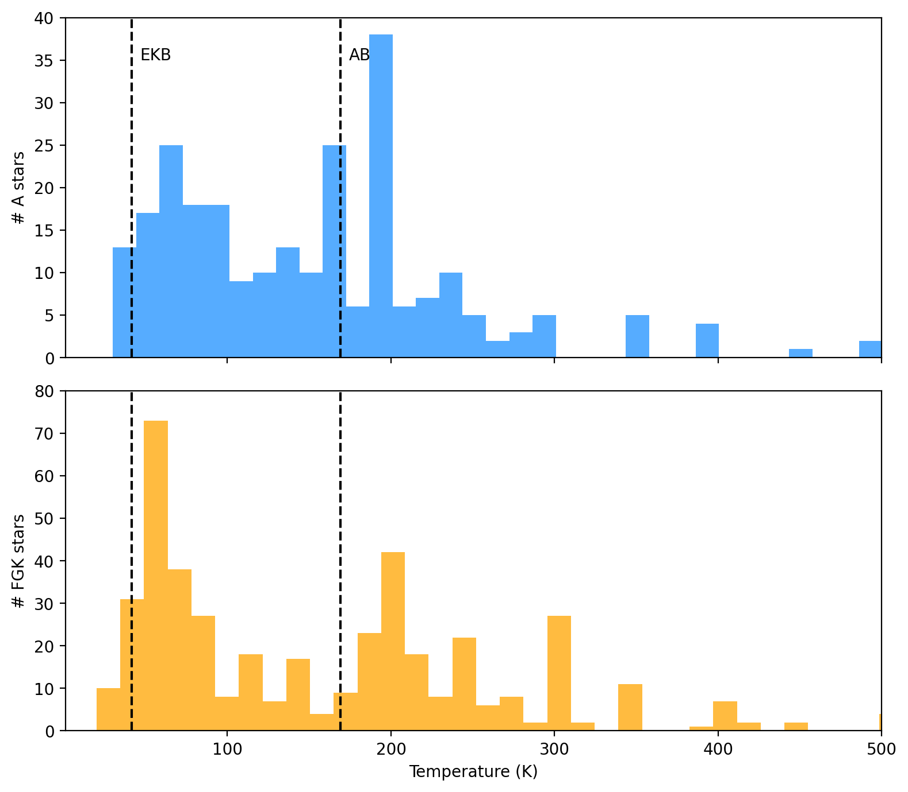
Teff > 7220 K
Teff < 7220 K
Data from Cotton & Song (2016)
Notes:
Such systems have had their IR excess detected. In the histogram plot, shows a sample size of approximately 500 stars, where the blue represents A Stars and the orange represent FGK stars that have an effective temperature less than 7220K. The dashed lines represents the temperature of our Solar System’s Edgeworth-Kuiper and Asteroid Belts respectively, where we mainly adopt a single or two temperature model when applying to debris discs.
In modelling such systems, we know grains do not act like blackbodies as they are inefficient absorbers and emitters, typically for grains of sizes of around 1 micron. So, applying a radiative transfer code that takes in account the grain size, stellar distance and composition will yield better flux estimates of debris discs.

Slide 11
Spitzer
IRAS
Herschel
ALMA
Notes:
IRAS –
Herschel: 70/100/160um PACS (Photodetector Array and Spectrometer)
250/350/500 um
ALMA – Interferometer
Atacama Large Millimeter/submillimeter Array (ALMA)
Interferometer of 66 radio telescopes
Operates at wavelengths of 320 to 3600 microns
Spitzer IR Telescope both imaging and spectral capabilities
Case Study

Slide 12
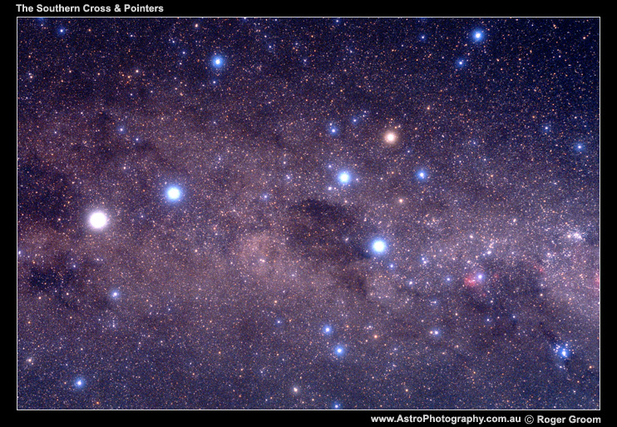
Case Study: HD 105211 | Eta Cru

Slide 13
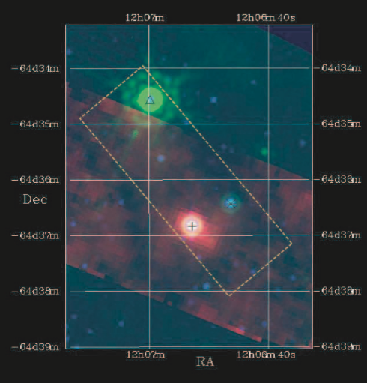
Spitzer Observation
of
HD 105211
Beichman et. al. (2006)
Notes:
Example: First detection of dusty debris for HD 105211 (2006)
Start of case study slides | kick off – motivation | Ignored for a long time due to be near the galactic plane
Composite image of the field surrounding HD 105211 (plus sign).
Spitzer MIPS: green (24um), red (70um) / overlaid in blue is 2MASS Ks band (2.16 um)
IRAS Scanning beam (dashed yellow rectangle)
CL Cru (triangle) / CPD -63 2145B (asterisk) – thought to be a binary companion of HD 105211

Slide 14
CASE STUDY: HD 105211
Spectral Type: F2 V (Gray et. al. 2006)
Luminosity: 6.6 times brighter than our Sun (Allende Preito & Lambert 1999)
Distance: 19.76 parsecs (van Leewen et al. 2007)
Age: 1.30 – 3.99 Gyr (Gray et. al. 2006)
Temperature: 7244 K (Gray et. al. 2006)
First Identified as a Debris Disc with Spitzer – 70 micron (Werner et al. 2004)
Notes:
Describing HD 105211 | Stellar parameters
Big debris spitzer
Age
F2 V star

Slide 15
HD 105211 – Archival Data – Optical/IR
Flux [Jy]
Wavelength [µm]
Notes:
Auxillary Data for HD 105211
Optical and Near infrared data
Illustrative purposes only

Slide 16
HD 105211 – Stellar Model
Flux [Jy]
Wavelength [µm]
Notes:
Model the emission from the photosphere

Slide 17
HD 105211 – IRS Spectrum
Flux [Jy]
Wavelength [µm]
Notes:
Simplified stellar spectrum 6000K (Black Body Curve)
Spectral Data

Slide 18
HD 105211 - MIR
Flux [Jy]
Wavelength [µm]
Notes:
Simplified stellar spectrum 6000K (Black Body Curve)
Spectral Data

Slide 19
HD 105211 – Far IR/Sub-mm
Flux [Jy]
Wavelength [µm]
Notes:
Herschel + ALMA 1.3mm
How big is this disc? Cannot be obtained using an SED
Degeneracy between grain temperature and location
Cannot assum BB grains
Could fit a BB to estimate the position of the disc but grains do not act as black bodies
Multi-wavelength resolved imaging

Slide 20
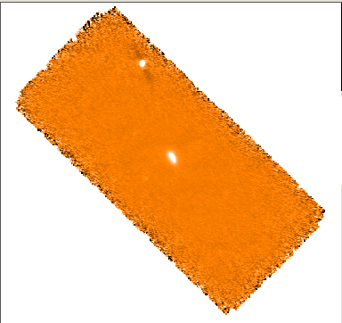
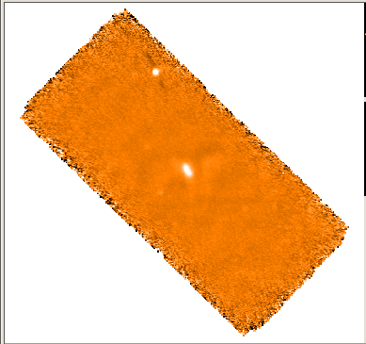
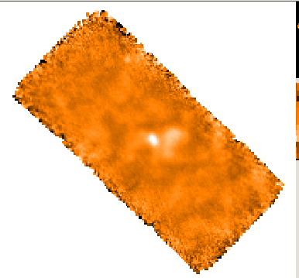
Herschel PACS Original Maps
North
70 µm
100 µm
East
160 µm
Notes:
Aperture Photometry | PACS (Photodetector Array and Spectrometer)
70 & 100um use an aperture radius of 24 arcsec
However, a smaller aperture of radius 17 arcsec was used for the 160um (despite the larger beam size of 11.8”) because of a bright, nearby structure to the west.
Fluxes are both aperture corrected and colour corrected.
70um / Beam Size: 5.8”
100um / Beam Size: 7.8
160um / Beam Size: 11.8”

Slide 21
Image Analysis | Original Images
Hengst et. al. 2017
Notes:
1 arcsecond is approximately 20 au

Slide 22
Image Analysis | Measuring Extent
Notes:
In Matlab, the extent of the semi-major and –minor axes were derived from a 2D Gaussian fit to HD 105211. In this process, Matlab in-built function to determine the FWHMs along each axis. Thus, enabling to determine the extent of HD 105211 along the semi-major and –minor axes. This is applied to all three wavebands.
For the 70 & 100um images semi-major length: 160 au semi-minor: 91au
160um image: semi-major 192 au / semi-minor: 141 au
Disc inclination in respect to the sky is determined by inverse cosine of the ratio of semi-minor to the semi-major: 70/100 55 degrees (consistent) 160 43 degrees.
Discrepancies are possibly due to rising level of background contamination (160) and having larger beam size.

Slide 23
Point Spread Function
Notes:
As it is a space observatory, then the telescope is only diffraction limited. (As oppose to seeing limited – i.e. being limited by the ‘seeing’ conditions of Earth’s atmosphere). The PSF is necessary to estimate the radial location of the dust.
A bright calibrator selected for a reference/instrument PSF which is required in either a convolution or deconvolution procedure to determine radial distance of the dust. Requirements, it would need to be a nearby bright star that is observed in all three wavebands. There are 5 accepted fiducial stars that we can use, the one presented here is Alpha bootis. To emphasis the structure of the diffraction pattern … (next slide)

Slide 24
Point Spread Function
Notes:
I have forced the colour gradient to show the Herschel’s trefoil pattern (three diffraction limbs). These images would need to be rotated to same telescope angle that the corresponding object was measured at. Before starting any image analysis of your selected object. Specifically, determining the radial distance of the dust in your system. There are two ways to this. Firstly….

Slide 25
Deconvolution | HD 105211
Hengst et. al. 2017
Notes:
A PSF normalised to the stellar contribution expected at the wavelength of emission was subtracted from the original map.
This resultant image was then deconvolved with the original PSF to reveal the disc architecture only.
To measure the radial location, apply a 2D Gaussian would not appropriate because you have no central maximum.

Slide 26
Radial Profiles
of
HD 105211
Hengst et. al. 2017
Notes:
We have flux as a function of distance for long axis (first column) and short axis (second column)
Dashed lines representing extent of deconvolved images
Red represents the extent of the original images
Solid black line represent the stellar contribution (which has been exaggerated for comparison)
For the long axis you can see two different radii locations for the clumps – this suggest asymmetry for HD 105211. To confirm, a disc model was created based on our information in our images and SED profile.
Mean location of grains
70: 93 - 115
100: 79 - 117
160: 67
Mean location of the grains/belt is around ~90au
It is all well and good to find the radial extent of the debris but it would be good to determine grain properties

Slide 27
Modelling Grain Emission
Notes:
Radiative Transfer Modelling
How hot is determined by
Distance to grain
Grain size
Assume grains are spherical and follow Mie Theory

Slide 28
Radiative Transfer
Notes:
Wavelength of absorbed radiation is greater than the size of the grain, you get in-efficient emission -> hotter smaller grains
Wavelengths of absorbed radiation is smaller than the size of the grain, you have more efficient, -> cooler large grains and typically act like black bodies
This is why shorter wavelengths tend to trace smaller grains and longer wavelengths tend to trace larger grains or even planetesimals
Grains can also scatter the optical light.

Slide 29
Grain Temperature
Notes:
Sun like star. This plot is for Astro-silicate grains.

Slide 30
Grain Composition
Astrosilicate
MgFeSiO₄
ρ = 3.3 g/cm³
Dirty Ice
Ice coated silicate ρ = 2.0 g/cm³
Weingartner & Draine (2000)
Preibisch et al. (1993)
Notes:
Astrosilicate – replicate observation of of astronomical objects
Dirty Ice – ice coated grains

Slide 31
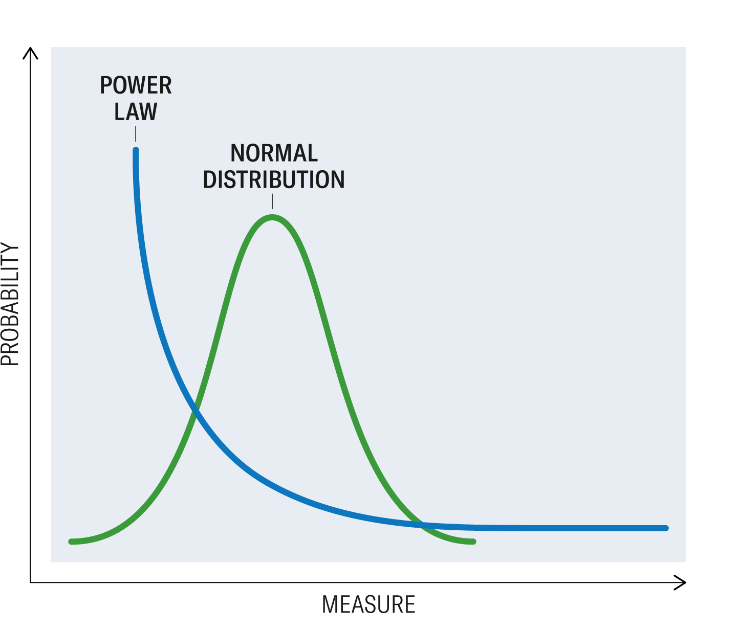

Grain Properties
Size distribution
$n ∝a^{−q}$
Density Distribution [power law, Gaussian, other?]
3 < q < 4
Notes:
Radiative Transfer Modelling
Estimate where the grains are in the disc and determine the subsequent emission (be it either Thermal or Scattter emission)
Collisional Cascades
Power law distribution definite by exponent -q
Traditionally, modelling of grains has assumed that they are uniformly distributed either using a power law or Gaussian Distribution irrespective of size.
I wanted to take this a step further.
Grains are assumed to be moving a circular orbit

Slide 32
Grains Forces
F_{grav}
F_{rad +} F_{sw}
F_{drag}

Slide 33
β - Ratio
(e.g. Burns et. al. 1979)

Slide 34
Elliptical Orbit
v_{k}
θ
a = semi-major
r_{i}
Notes:
Eccentricity + Semi-major axis

Slide 35
β - Ratio
Notes:
Grains assumed to released from a circular orbit and experience Keplerian velocity

Slide 36
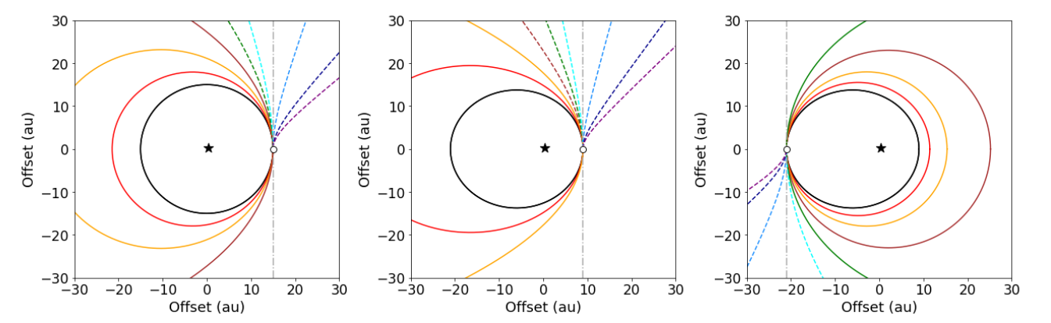

F_{grav}
$$β= \frac{F_{rad}}{F_{grav}}$$
F_{rad}
Horner et. al. 2020
Notes:
For simplisticicity here, I have only adopted radiation pressure.To account for radiation pressure, I have adopted the beta value, i.e. the ratio between radiation and gravitational forces acting on the grain. So when beta increases from 0, the grain’s orbit becomes more eccentric.
Here, we have three different scenarios of a planetesimal belt (representative as black line) around a star (represented as a black star) and the grain release point (represented as a white circle).
The left image shows different beta values when the grains are released from a planetesimals that are on a circular orbit
The middle and right image depicts the planetesimals being eccentric orbits where subsequent grains are released from periastron and apastron respectively.
The solid coloured lines is when the grain’s orbit bound by the star and the dotted lines is when the grain’s orbit is unbounded.
For my proposed simple model presented, I will only look at planetesimals that are on a circular orbit with the subsequent grains produced are on bound orbits, I.e. when beta is between 0 and 0.5.

Slide 37
Beta vs Grain Size
Hengst et. al. 2022 (in prep)
Notes:
Blow out ranges

Slide 38
Radiation Pressure Affected Grains
Number Grain Density [N/au]
Parameter | Value
r_{m} [au] | 40
σ_{r} [au] | 5
r_{in} [au] | 20
r_{out} [au] | 60
S_{min} [μm] | 0.5
q | 3.5
M [M⊕] | 0.02
Notes:
To illustrate this basics of this model, here I have assumed a planetesimal belt with a Gaussian distribution centred at 40 au located surrounding a Sun-like star at 10pc away, and grains are produced in a steady state collisional cascade with a minimum grain size of half a micron.
Blue lines represent the non-beta grains and red lines represent the beta grains.
In the left image, shows the number of grains (regardless of size) as a function of distance.
It can be seen that grains have been pushed out onto eccentric orbits far beyond the planetesimal belt, hence changing the underlying structure of the disc. For beta value greater than 0.1, yields noticeable change from the original circular orbit of the planetesimals.
The resultant SEDs on the right show the direct or thermal emission from the grains with the Sun-like spectra for reference.
For longer wavelengths, the two models have a similar flux, however, at shorter wavelengths, the emission is dimmer when considering radiation forces as smaller grains get pushed out farther from the host star to become cooler.
It is noted that the beta grains have larger peak wavelength.

Slide 39
Impact of size distribution on SED
Hengst et. al. 2022 (in prep)
Notes:
Taking a step further, to then explore how the SED is representing according to a grain size regime, which will then impact on how we image such systems. Here, again I have assumed a planetesimal belt with a Gaussian distribution centred at 40 au located surrounding a Sun-like star at 10pc away but with a minimum grain size of 0.6 micron such that no grains will be blown out of this system. I have also included an estimate of the scattered light in the emission to gain better insights across grain regimes.
I have split up into three different size regimes.
Left: < 1 um
Middle: between 1 and 10 um
Right: > 10 um
For < 1: for mid-IR the non-beta grains > flux beta grain | for Far IR/sub-mm beta grains > non-beta grains
1-10um: non-beta grains slightly greater flux at optical to mid-iR
10um: no change
Although, none of these plots indicate the spatially location of the grains, which is achieved through imaging the data.

Slide 40
Imaging
Hengst et. al. 2022 (in prep)
Notes:
To gain insights into the flux emanating as a function of stellar distance, I have selected 4 wavelengths 1, 10, 100 & 1000 um an extracting distance information to then create image plots.
When constructing these image plots, the stellar distance values of the grains, which are the 1D radial components, have been transformed to be axis-symmetric annulus creating these 2D image plots. Each column is representative of the monochromatic wavelength chosen.
Top row: non-beta grains
Middle row: beta grains
Bottom row: image subtraction, non-beta minus beta grains
X&Y axes are in units of au, showing the offset from centre of the debris annulus
It is noted that beta grains 1 and 10 um are dimmer and slightly extended , whilst 100 and 1000 um are similar in comparison to their non-beta counterparts.
Slight extensions from the main planetesimal belt can be seen in 1, 10 and 100. This is particular interesting for the 100 um, where you would not typically would expect grains to be present. But again this could be attributed due to the smaller grains getting pushed out farther producing cooler grains. Further investigation, certainly is warranted.
More pronounced halo, etc

Slide 41

HD 105211 – ALMA: 1338 microns
$$Rm \sim 134 au$$
σ_{r} ~10 au
Notes:
Revisiting HD 105211
$F_{\nu_{\rm belt}}$ (mJy) = 2.4447 +0.1512 -0.1488
$R$ (au) = 133.8580 +2.0019 -1.1484
$\Delta R$ (au) = 23.4610 +5.5520 -5.8996
$i$ ($^{o}$) = 68.1243 +0.8630 -1.1304
PA ($^{o}$) = 28.9604 +0.5921 -0.9532
$h$ = 0.0829 +0.0142 -0.0155
$F_{\nu_{\ast}}$ (uJy) = 172.9764 +16.3582 -15.6867 $
\Delta$RA$_0$ ('') = -0.0233 +0.0416 -0.0441
$\Delta$Dec$_0$ ('') = -0.0223 +0.0362 -0.0370 w$_0$ = 0.2954 +0.0007 -0.0006

Slide 42
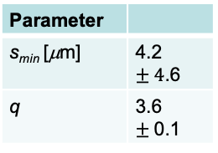
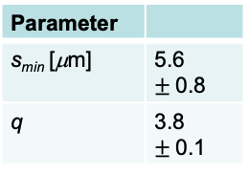
Spectral Energy Distributions (SED)
Astrosilicate
Dirty Ice
HD 105211
Parameter
s_{min} [μm] | 5.6 $±$0.8
q | 3.8 $±$0.1
HD 105211
Parameter
s_{min} [μm] | 4.2 $±4$.6
q | 3.6 $±$0.1
Flux [Jy]
Flux [Jy]
Wavelength [µm]
Wavelength [µm]
Hengst et. al. 2022 (in prep)
Notes:
Astrosilicate grains vs Dirty Ice
Larger uncertainty with minimum grain size for dirty ice – and you can argue the ‘best’ solution did not actually fit.
Where Astro-silicate did.

Slide 43
Number Density
Astrosilicate
Dirty Ice
Hengst et. al. 2022 (in prep)
Notes:
This makes sense when only considering Radiation Pressure as a grain force. I haven’t included Solar Wind, nor drag forces (or the inward migration of grains due to pointing-robertson effect brought on grains) !
Mean distance of grains here is about 150~au. However, when compared to the Herschel Images (Radial plots) the debris was detected at a Mean distance around 90 au. This is only preliminary results as the next iteration of the model will need to consider both Solar Wind and drag forces.

Slide 44

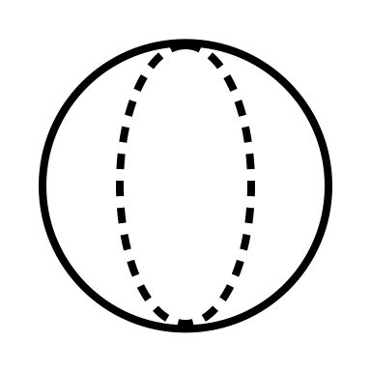


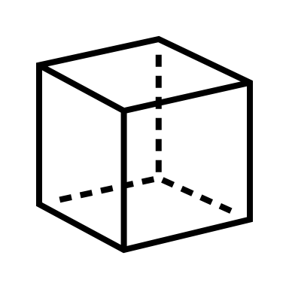


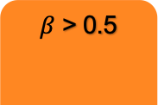
Conclusions
Limitations
Collisions
$β$ > 0.5
Dust Distribution
Sub-micron sized grains that are impacted by radiation forces can change the density dust distribution of the grains in the disc
Future Work
Stellar Wind
P-R
SEDs
Due to the change in the dust distribution of the grains leads to lower emission at shorter wavelengths compared to uniform dust distributions
3D
Temporal
Images
Contact
The lower emission at shorter wavelengths will also impact the expected disc architecture seen in images observed mainly in the mid-infrared regime
E-Mail
shane.hengst@usq.edu.au
Notes:
In conclusion:
When radiation pressure forces are considered they change the distribution of the dust compared to uniform models. Namely moving the sub-micron sized grains on more eccentric orbits.
The dust grains that are susceptible to radiation pressure in debris discs are also those responsible for producing emission (or absorption) features at infrared wavelengths. Modelling the spatial distribution, emission, and dynamics of such grains observations, e.g. JWST, is one of the potential applications of this tool.
Currently, we do not consider collisions between grains and it also ignores grains corresponding to beta greater than or equal to 0.5 (known as sub-blowout grains) that could contribute to a halo to the debris disc, which we may consider in future work.
In the future I would like to consider stellar wind force and drag as other forces acting on the grains when considering the beta values, which would be very interesting to apply to the understanding of comet tails.
Currently the model is 1-D dimensional in the radial direction and so by making it 3D, it will be able to help improve our understanding of the disc architecture, for example: inclined orbits
The model has been built to assume a static case where grains are already distributed along their orbits, it would be good to incorporate a time evolution case to further help disc architecture and any interactions with planets, for example.
Grains released at different velocities.
If you have any questions, or if you are interested in collaborating with me, I can be contacted via my email: shane.hengst@usq.edu.au
Thank you for very much your attention !

Slide 45
Thank you for your attention!
Supervisors: Prof. Jonti Horner, Dr. Jonty Marshall, and A/Prof. Stephen Marsden
Image Source: Scitechdaily.com

Slide 46
β - Ratio
(Burns et. al. 1979)
Notes:
Note: ignore Solar Wind effects for now

Slide 47
HD 105211 | Conclusions
Black body temperature of dust: T_{BB} ~ 50K corresponds to a blackbody radius: R_{dust} ~ 80 au
Potential asymmetry was observed: two clumps of dust located at ~86 au and ~116 au
A disc model did not reveal asymmetry but a broad disc of ~100 au starting 87 au
Requiring further observations to pin down asymmetry
Notes:
Sarah Dodson-Robinson paper conflicting conclusion/analysis – disc structure
Requiring further observation at higher angular resolution and longer wavelengths to determine better architecture
Issue resolved ALMA or Sofia or JWST
Published paper MNRAS (another conclusion slide)

Slide 48
Astrosilicate – Posterior Plots – HD 105211

Slide 49
Dirty Ice – Posterior Plots – HD 105211

